Slide 1
CISC2003 OOP AND DATA STRUCTURES
1
Lab 6
TA: Zhang Wenyuan
yc07421@um.edu.mo
E11-2016
Notes:
Chapter 1 - 1

Slide 2
Outline
2
Get familiar with doubly linked list
Review Assignment 1- Part 1
(Refer to Arrays and Linked Lists slide 55-66)
Notes:
Chapter 1 - 2

Slide 3
Assignment1- Part 1
3
Write a Java program that inputs a document and then outputs the frequencies of each alphabet character that appears within that document.
txt or input string are both acceptable.
Input txt, worth higher score.
Notes:
Chapter 1 - 3

Slide 4
Assignment1- Part 1
4
How to input a txt file?
Use BufferedReader
import java.io.BufferedReader;
import java.io.FileReader; //import header
FileReader file = new FileReader("./test.txt");//open a file
BufferedReader reader = new BufferedReader(file);
String text = "";
String line = reader.readLine();//read a line each time
Notes:
Chapter 1 - 4

Slide 5
Assignment1- Part 1
5
How to count character?
Dumb way | Clever way
If(s.charAt(0)==‘a’): If(s.charAt(0)==‘b’): If(s.charAt(0)==‘c’): ………… | With ASCII table
Notes:
Chapter 1 - 5

Slide 6
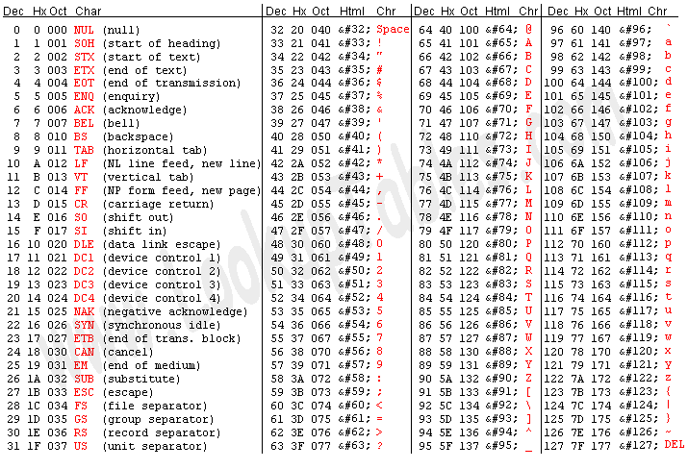
Assignment1- Part 1
6
What is ASCII?
ASCII is a character encoding standard for electronic communication. ASCII codes represent text in computers, telecommunications equipment, and other devices. Most modern character-encoding schemes are based on ASCII.
In other words : It’s a table to transfer all the character to corresponding number.
Notes:
Chapter 1 - 6

Slide 7
Assignment1- Part 1
7
How to count character?
Clever way:
for(char ch = 'a'; a <= 'z'; a++)
{
if(s.charAt(0)==ch)
}
This is working because char is also represented by number as ASCII.
Notes:
Chapter 1 - 7

Slide 8
Practice
8
Create a doubly linked list of n nodes and count the number of nodes
(Using the code in the lecture note first, then the following)
//countNodes() will count the nodes present in the list
public int countNodes() {
int counter = 0;
//Node current will point to head
Node<E> current = head;
while(current != null) {
//Increment the counter by 1 for each node
counter++;
current = current.getNext();
}
return counter;
}
public static void main(String[] args) {
DoublyLinkedList dList = new DoublyLinkedList();
//Add nodes to the list
dList.addFirst(1);
dList.addLast(2);
dList.addLast(3);
dList.addLast(4);
dList.addLast(5);
//Displays the nodes present in the list
dList.display();
//Counts the nodes present in the given list
System.out.println("\nCount of nodes present in the list: " + dList.countNodes());
}
}
//display() will print out the elements of the list
public void display() {
//Node current will point to head
Node<E> current = head;
if(head == null) {
System.out.println("List is empty");
return;
}
System.out.println("Nodes of doubly linked list: ");
while(current != null) {
//Prints each node by incrementing the pointer.
System.out.print(current.getElement() + " ");
current = current.getNext();
}
}
Notes:
Chapter 1 - 8

Slide 9
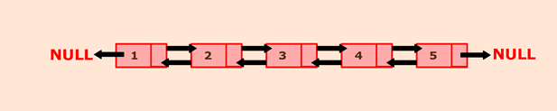
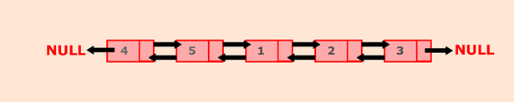
Exercise
9
Develop a general program: Rotate a doubly linked list by N nodes.
Original List:
List after rotating it by 3 nodes:
Submission Guideline
1. Please submit .java file and screenshot to UMMoodle.
2. Do not copy your classmate’s codes, otherwise both of you will lose scores.
3.Submission deadline: 11:50pm, 2/11/2022.
(It will better if you can submit at the end of this lab.)
Notes:
Chapter 1 - 9

